Slide 1





team Avatars
Tasks completed
Challenge 1: Enhancing TTS functionality by
1. Filtering offensive words
2. Adding diacritical marks to Arabic words
GPEC Challenge
team members
Nikhil Kapila
Isham Rasik
Muhammad AlBarham

Slide 2

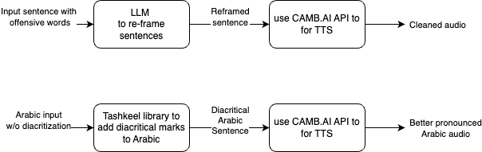

Our skateboard Filtering offensive words using LLMs
Using power of LLMs to filter out TTS inputs and prevent hate speech / negative sentiments
Problems solved:
Remove/ filter out hate speech
Future steps:
Extend this to dubbing. Possible problems: Can lead to a longer output compared to input.

Slide 3
Our “extended” skateboard Adding diacritical marks to Arabic sentences using external libraries
Problems solved:
Adding diacritization helps in pronouncing Arabic sentences which can sometimes even change meanings.
Issues:
It could be possible that the TTS model already takes care of this task.

Slide 4
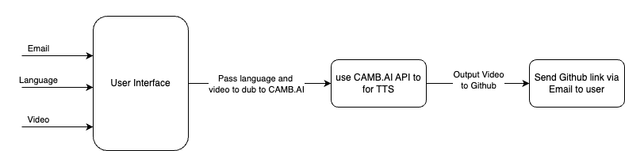
GPEC challenge Dubbed video e-mailed to user
The program dubs a YouTube video link and emails the user the dubbed video in a specific language.
Future steps:
Ability to record instead of using YouTube video links.
???

Slide 5

Questions?

